Slide 1
Introduction to computers

Slide 2
Agenda
Applications of Computers
Introduction
Hardware/Software
Block Diagram
Components
Buses
Computer Networks

Slide 3
Introduction
Applications of Computers
In Business and Industry
In Publication Field
In Education Field
In Government Organizations
In Medical Field
In Science Field
In Entertainment Field

Slide 4
Definition
Computer is an electronic device which accepts data as input through input device, process the data according to the instructions, stores data if required and provides output through appropriate output device.

Slide 5
Parts
Computer can be divided into two:-
Hardware
Tangible functions
Software
Instructions working over hardware.

Slide 6
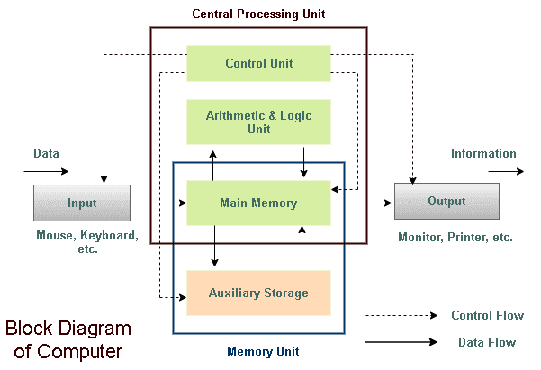
Block Diagram

Slide 7
INTRODUCTION TO COMPUTERS
Definition:
A computer is an electronic machine, devised for performing calculations and controlling operations that can be expressed either in logical or numerical terms.
Applications:
The applications domain of a computer depends totally on human creativity and imagination it covers a huge area of applications including education, industries, government medicine, scientific research, low and even music and arts.
• Millions of complex calculations can be done in a mere fraction of time
• Difficult decisions can be made with unerring accuracy for comparatively little cost

Slide 8
The block diagram of the computer system have the following three units, each functional unit corresponds to their basic operations performed as described in details.
(a) Input unit
(b) Central processing unit
(c) Output unit

Slide 9
Input Unit
Accept data and instructions from the outside world.
• Convert it to a form that the computer can understand
• Supply the converted data to the computer system for further processing
• The input unit is used to send information or instructions or commands to the computer. The data received from the input unit is immediately stored in main memory and the processed.

Slide 10
Following are the some of the input devise.
(i) Keyboard
(ii) Mouse
(iii) Light pen
(iv) Joystick
(v) Ocr (optical character recognizer)
(vi) MICR (magnetic ink character recognizer)
(vii) OMR ( optical mark recognizer)

Slide 11
Central Processing Unit (CPU)
• It performs all calculations and all decisions.
• It controls and co-ordinates all units of the computer
• It interprets instructions of a program
• It stores data temporarily and monitors external requests

Slide 12
The CPU is sub-divided into the following sub-system.
(i) Control unit
(ii) Arithmetic and logical unit
(iii) Memory unit
(a) Primary storage
(b) Secondary storage.

Slide 13
Control unit
The control unit instructs the computer how to carry out program instructions. It directs the flow of data between memory and arithmetic logical unit. The input unit does not know when to receive data and where to put the data in the storage unit after receiving it similarly, the control unit instructs the input unit where to store the data after receiving it from the user.

Slide 14
In the same way, it controls the flow of data and instructions from the storage unit to ALU during program execution the control unit fetches instructions from the primary memory, decodes them to determine the operations required, and then sets up instructions execution.
Arithmetic And Logical Unit
Arithmetic and logical unit performs all the arithmetic and logical operations. Arithmetic operations like addition, subtraction, multiplication and logical operations, such as comparisons are performed in ALU. All calculations are performed in the arithmetic and logical unit (ALU) of the computer ALU also does comparisons and take decision

Slide 15
Memory unit
Memory is the part of computer which holds data for processing and other information it is also called as main memory or primary memory.
A device that stores program instructions or data used by the CPU when performing a given function.
Memory is a device, which is used to store information temporality/permanently, it is the place where the information is safekeeper. Secondary memory, such as disk storage, is functionality considered I/O because it is accessed through the I/O system.

Slide 16
Primary storage
The primary storage is also called as “main memory” stores and access information very fastly. This is generally used to hold the program being currently executed in the computer, the data being received from the input unit, the intermediate and final results of the program.
Primary storage is also known as system memory, internal, temporary and “RAM”
▪ Installed on the main computer board (motherboard)
▪ Typically comprised of ICs (integrated circuits)
▪ Fast access – usually in the order of nano seconds

Slide 17
Secondary storage
The secondary storage is also known as Auxiliary Storage it may store several programs, documents, databases etc.
The program that we want to run on the computer is first transferred to the primary memory before it can run. Similarly, after running the program if need to save the result, we will transfer them to the secondary storage.
The secondary memory is slower and cheaper than the primary memory. Some of the commonly used secondary memory devices are Floppy diskette, Zip diskette, Hard disk and Magnetic disks and Tapes etc.

Slide 18
Output unit
Devices used to get the response or result of a process from the computer is called output unit is the communication between the user and the computer.
The output unit of a computer provider the information and results of a computation to the outside world.
Commonly used output devices are.
▪ Visual display unit (VDU) or monitor
▪ Printer
▪ Computer output microfilm
▪ Plotter.

Slide 19
I/O Devices
Printers
CRT
LCD
Scanners

Slide 20
Secondary Storage Devices
HDD
CD
DVD
Etc.

Slide 21
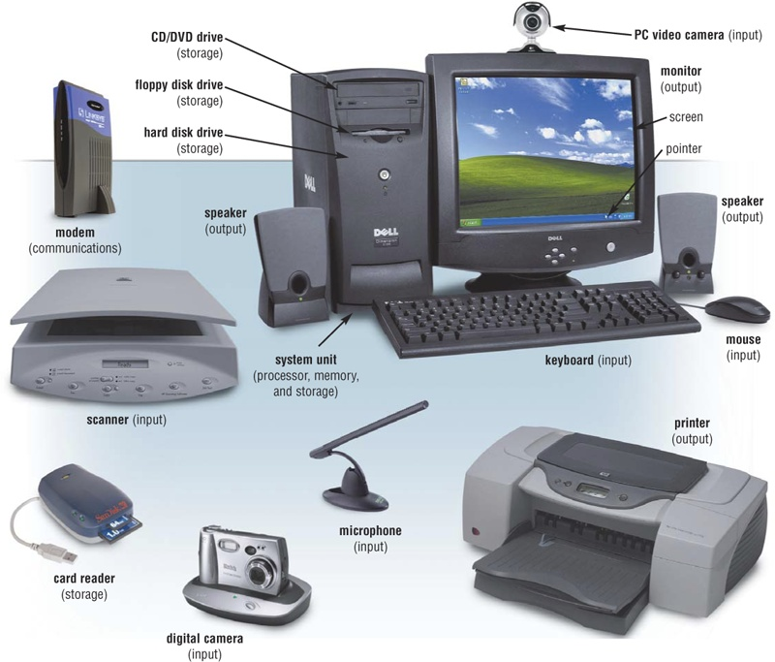

Slide 22
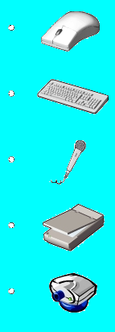
Input Devices
Hardware used to enter data and instructions
Mouse
Keyboard
Microphone
Scanner
Webcam

Slide 23



Output Devices
Hardware that conveys information to a user
Monitor
Printer
Speaker/Headphone

Slide 24
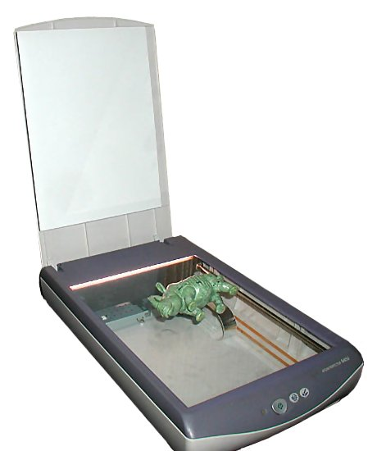
Flat Bed Scanner

Slide 25
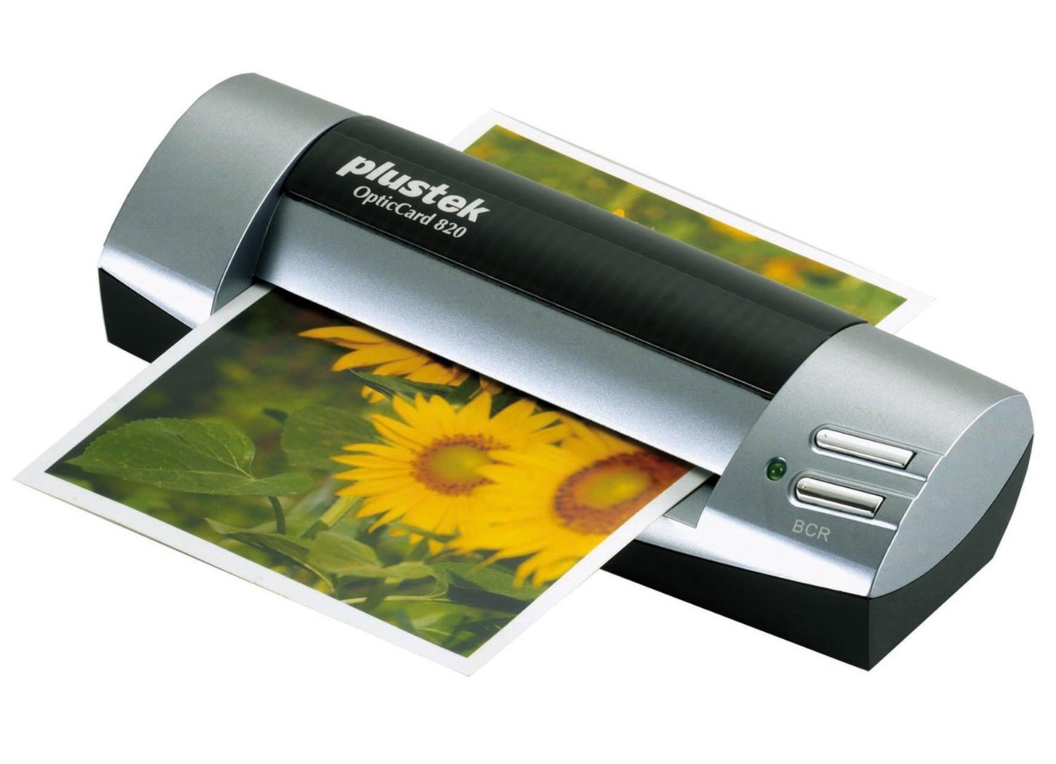
Sheet Fed Scanner

Slide 26
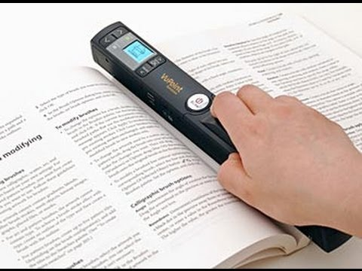
Hand Held Scanners

Slide 27
Continues..
Scanning technology of all 3 scanners are same.
The only difference is in the head movement.
In flat bed paper is static and head moves beneath the paper.
In sheet fed head is static and paper moves.
In hand held both the paper and head is static and the whole scanner moves over the paper.
Comparisons

Slide 28
Printer
An external hardware device responsible for taking computer data and generating a hard copy of that data. Printers are one of the most commonly used peripherals and they print text and still images on the paper.

Slide 29
Types of Printers
Impact printer – Print head touches the paper
Example : Dot-metrix printer
Non impact printer – Print head dose not have a contact with the paper
Example : Ink-jet printer, laser printer etc..

Slide 30
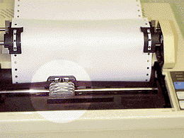
Impact Printer

Slide 31
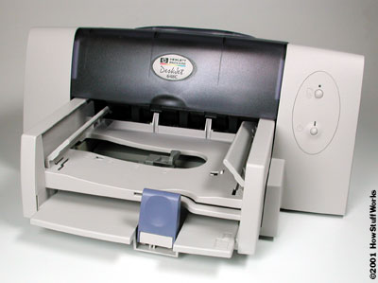
Non Impact Printers

Slide 32
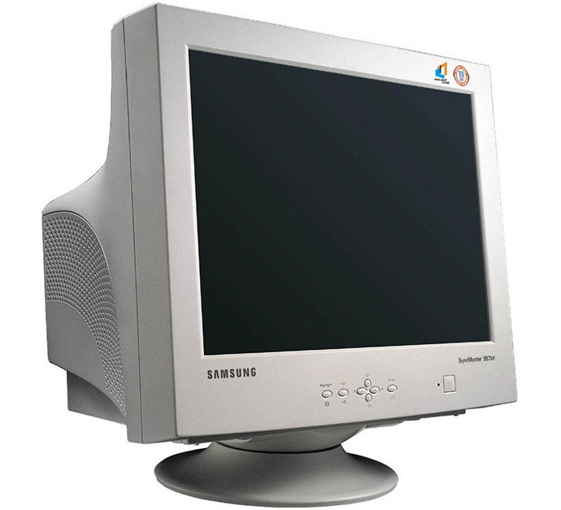
Display Devices :-CRT(Cathode Ray Tube)

Slide 33
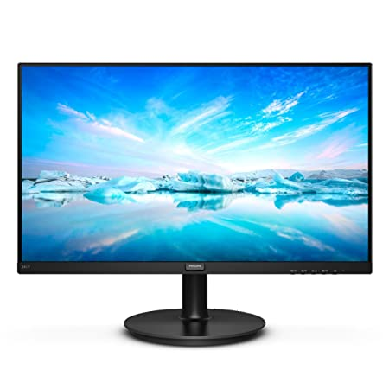
LCD Monitor

Slide 34
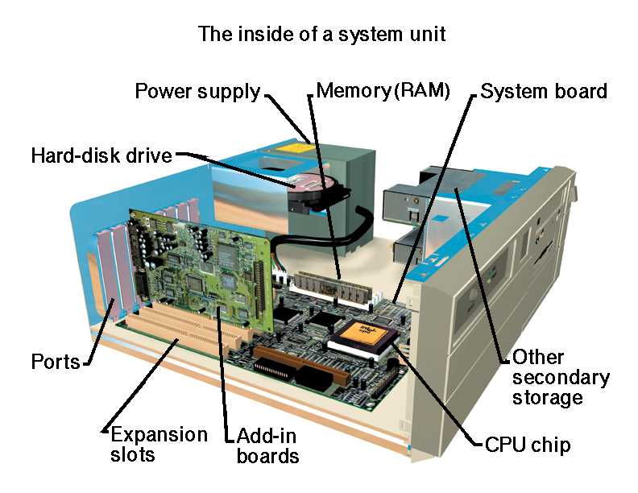
Inside a CPU

Slide 35
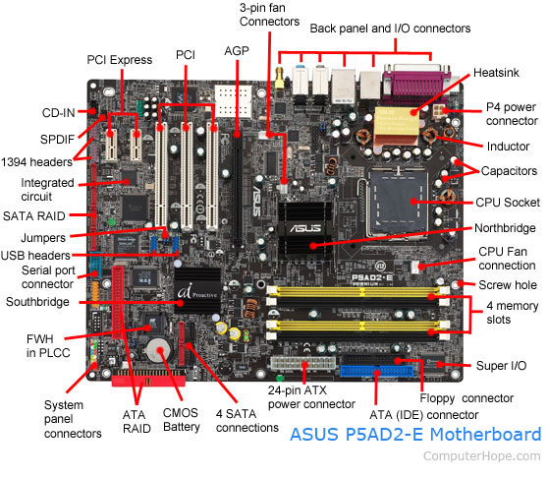

Slide 36
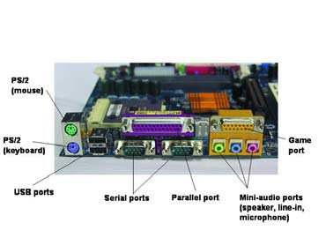
Ports

Slide 37
Motherboard
Primary circuit inside the computer
Components connected to motherboard are Central processing unit(CPU), Memory slots, drives and other peripherals.
Provides the electrical connections by which the other components of the system communicate. It also connects the central processing unit and hosts other subsystems and devices.
An important component of a motherboard is the microprocessor's supporting chipset, which provides the supporting interfaces between the CPU and the various buses and external components. This chipset determines, to an extent, the features and capabilities of the motherboard.

Slide 38
Components of a motherboard
1. Clock Generator
2. CPU socket
3. Memory Socket Memory error checking
4. ROM Bios
5. CMOS Ram
6. Battery
7. Chipset
8. Expansion Slot
9. AGP Port
10. IDE Ports
11. Floppy Disk port
12. IO Connectors/USB ports USB port add more printer ports
13. Main Power Connector1
14. Front Panel Connecting Pin

Slide 39
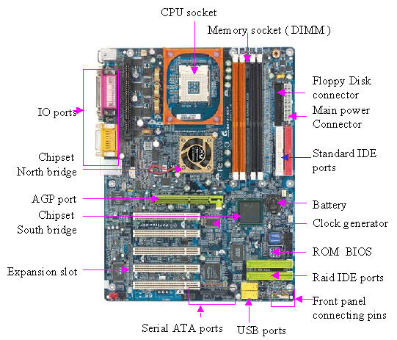
Chipset

Slide 40
Continues
Chip set is a set of IC.
The combination of the North and South bridge in a computer is called the chipset.

Slide 41
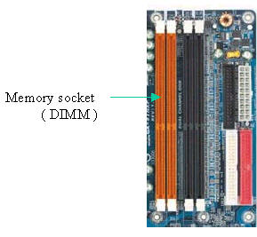
Memory Socket(DIMM)
There are 3 types of memory that currently popular used in the PC
1. RD RAM
2. DDR RAM
3. SD RAM

Slide 42
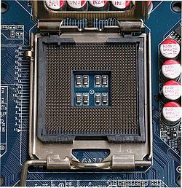
CPU Socket
A CPU socket or slot is an electrical component that attaches to a printed circuit board (PCB) and is designed to house a CPU (also called a microprocessor).
It is a special type of integrated circuit socket designed for very high pin counts.
CPU sockets on the motherboard can most often be found in most desktop and server computers (laptops typically use surface mount CPUs), particularly those based on the Intelx86 architecture.

Slide 43
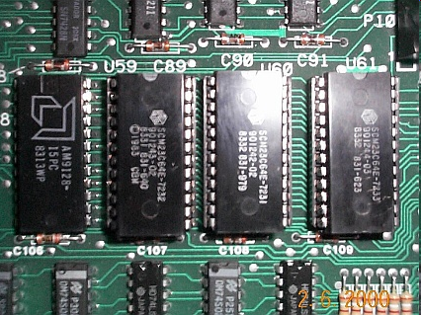
ROM BIOS
Read-Only Memory can be read but not changed. It is non-volatile storage: it remembers its contents even when the power is turned off.
ROM chips are used to store the instructions a computer needs during start-up, called firmware.
Some kinds of ROM are PROM, EPROM, EEPROM, and CD-ROM.

Slide 44
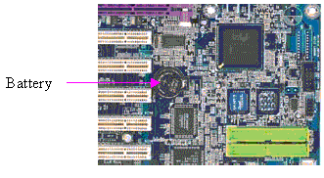
CMOS Battery
This is a 3 volt battery, this battery supplies the power to CMOS ROM for CMOS ROM to retain the information during system powered off, the battery may be last for 5 or 6 years

Slide 45
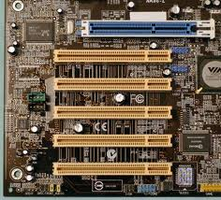
Expansion Slots
Expansion slot or Expansion bus is the slot that enable the user to add the adapter card for additional function to the system
Eg.
-Sound card or Multimedia
- LAN card.
-SCSI controller card.
- Internal Modem card.
-TV tuner card.
-Additional hard disc controller card.

Slide 46
AGP Port
AGP ( Accelerated Graphic Port ) port is a high speed data transfer port, this port is used by the display adapter card that demands so much data with in short period of time.

Slide 47
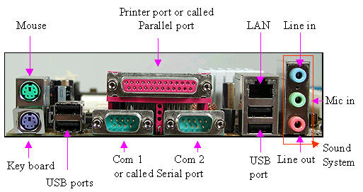
IO Connector/USB ports

Slide 48
Others
Co processors
Buses
Expansion Slots
ISA(Industry Standard Architecture)
MCA(Micro Channel Architecture)
EISA(Extended….)
VESA Local Bus(Video Electronics Standard Association)
PCI Local bus(peripheral Connect Interconnect)

Slide 49
Memory
ROM
RAM

Slide 50
Physical Memory Organisation
DIP(Dual In Line Package)
SIMM (single Inline Memory module)
DIMM (Dual Inline Memory module)

Slide 51
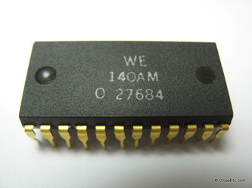
DIP

Slide 52
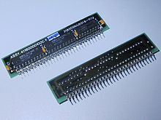
SIPP

Slide 53

SIMM

Slide 54
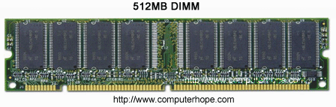
DIMM

Slide 55
Hard Disk
A hard disk drive is a sealed unit that a PC uses for nonvolatile data storage.
Secondary Storage Device.
Advantages
Storage Capacity
Reliability
Performance

Slide 56
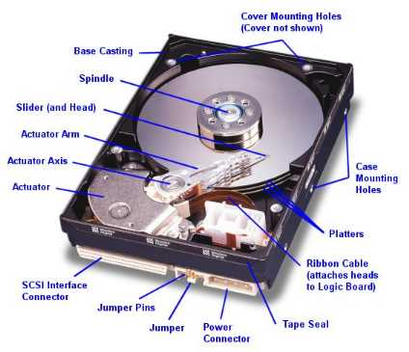

Slide 57
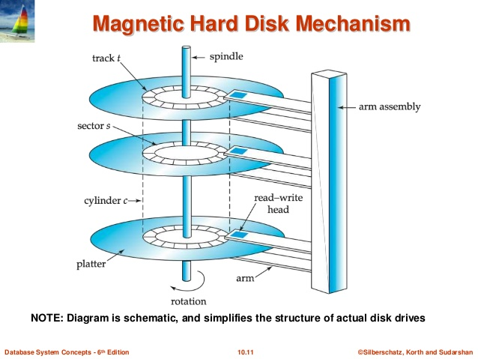

Slide 58
Components of a Hard disk
Disk platter
Read/Write head
Head arm/Head slider
Head actuator mechanism
Spindle motor
Logic board
Air filter
Cables & Connectors
Bezel/Front Face Plate

Slide 59
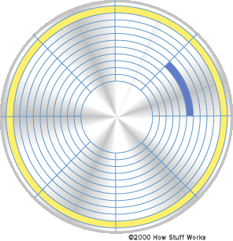
track
sector
head

Slide 60
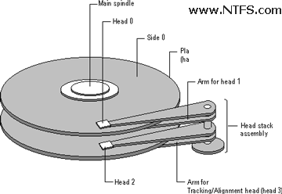
Side/Head
Numbering starts from 0. if there is 2 platters first side is numbered as 0 and last side is numbered as 3

Slide 61
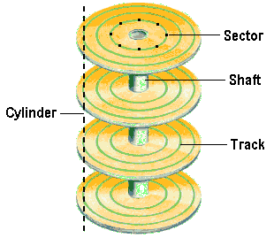
Track
Each side is divided into concentric circles called Tracks.
Numbering starts from 0.

Slide 62
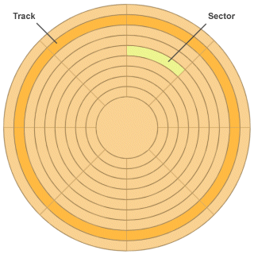
Sectors
Single track can store more than 5000 bytes.
So it is further divided into sectors.

Slide 63
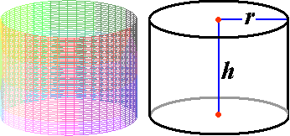
Cylinders
Data is stored in the cylinder by cylinder

Slide 64
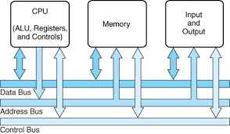
Buses
Address Bus
Data Bus
Control Bus

